Slide 1

Recruiting Students Tools
Presenter: Teaching Systems Inc.
Recruiting- Get them early
Tools QuickPart
Instant Success Module
CAD CAM CNC Exposure
Notes:
We need to expose, more student to a successful CAD-CAM-CNC experience, QuickPart is an instant success module that answers the question.

Slide 2
QuickPart-X 2010
  CAD/CAM/CNC Exposure
QuickPart in Jr. High exposes student to making motivational parts
Jr. Highs expose to technology and feed High Schools
High Schools feed Technical programs
Pass those students along
Notes:
Art introduction video, click on graphic

Slide 3
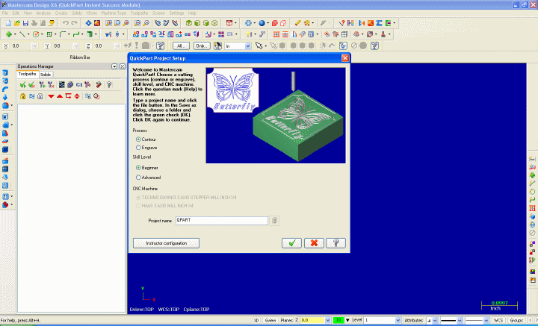
QuickPart-X 2010
QP Intro Video
Click Graphic
Notes:
Art introduction video, click on graphic

Slide 4
QuickPart-X 2010
    What is QuickPart-X
      Instant success module for CAD/CAM/CNC
      It is its own product
      It is not dependant on Mastercam
      or its next release
      It does not require a protection key

Slide 5

QuickPart-X Contour
What does it do?
  Contour – Contour toolpath
Centerline cutting
Contour Path Movie
Notes:
Cutter traces the artwork geometry.

Slide 6

QuickPart-X Engrave
What does it do?
  Engrave - V-cutter engrave toolpath
  Engrave refresher
Engrave Path Movie
Notes:
Notice how the walls taper, old world master carver look.

Slide 7
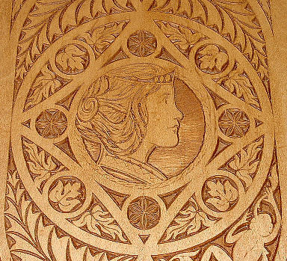
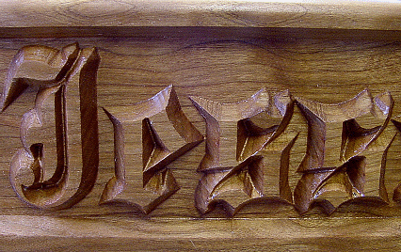

QuickPart-X Engrave
3D Engrave
  Chip Carving
  Embossing
Notes:
Gives you and old world master craftsman look

Slide 8




QuickPart-X Engrave
Engrave
  V-Cutter Only
  Verification
  Finished Part
Notes:
Engrave uses a V-cutter to get inside sharp corners, the toolpath ramps the cutter out of the stock on corners to give it a crisp sharp look

Slide 9




QuickPart-X Engrave
3D Engrave Options
  Chisel
  Emboss
  Emboss/Rough
  Chisel/Emboss/Rough
Notes:
Here we see the different looks that can be achieved.

Slide 10
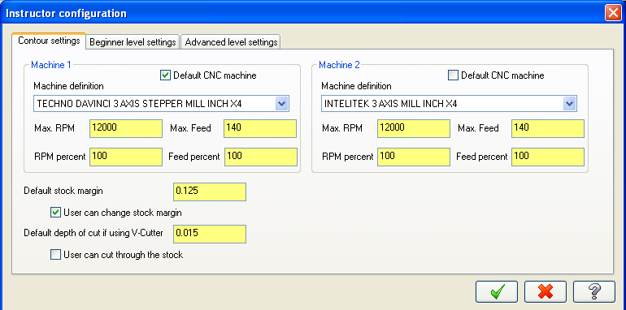
Instructor Configuration
Teacher Configuration
Teacher Config Movie
Notes:
Instructor can customize, parameters to fit their program, it is set up to work immediately, but if the instructors want to customize it to their curriculum or machine needs, no problem.

Slide 11

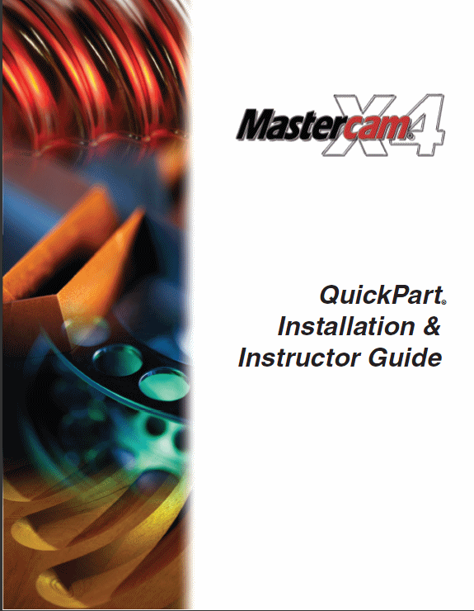
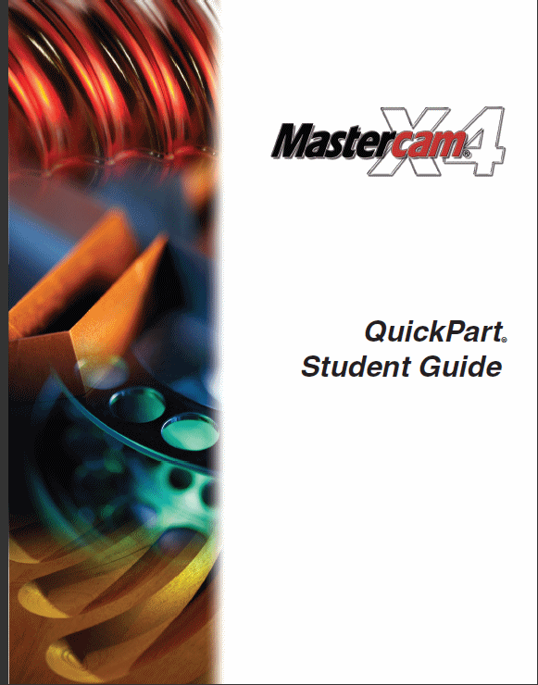
Documentation
  Context Sensitive Help
  Documentation in PDF
  Instructor Guide Student Guide
Notes:
PDF guides Installation and instructor.
Complete narrated videos on entire process of Contour and Engrave options as well as Teacher configuration.

Slide 12
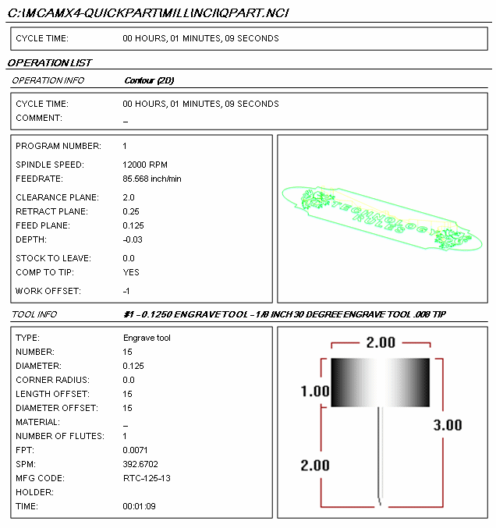
QuickPart-X Engrave
Setup Sheets
  Page three
    Operations list
    Cycle time
    Vital info
    Tool used
Notes:
Setup Sheets, allow the student’s to work independently, once done the run the setup sheet, and hand it to the instructor, with it the machine can be setup and run with out fear.

Slide 13
QuickPart-X Pricing
Standard Pricing
  Singe seat =$ 500
  Lab license = $1000 (Not a district or multi campus)
  Special Introductory Bundle Pricing
  One free QP for equal $ sale of Mastercam
    500 up to $999 single license
    1000 and over lab license
    Yes updates do count for this promotion.

Slide 14
CNC Software, Inc.
Recruiting- Non-tradition Students
X5 Tools Art
Notes:
We need to expose, more student to a successful CAD-CAM-CNC experience, QuickPart is an instant success module that answers the question.

Slide 15
CNC Software, Inc.
Mastercam Art Motivate
Bring in non-traditional students
Attracted by design and 3D surfaces.
Want to make art; text, logos, and jewelry
Bring them in with Mastercam Art.
These applications are just as advanced as mechanical applications.
Notes:
We need to expose, more student to a successful CAD-CAM-CNC experience, QuickPart is an instant success module that answers the question.

Slide 16
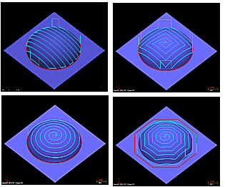
X5 Art Enhancements
Four new contained toolpaths
  Parallel horizontal
  Spiral Rectangular
  Spiral Circular
  Spiral follow
  boundary
Notes:
New Art tool paths, allow you to cut faster and better, producing better parts faster
These new toolpaths allow you to contain the toolpath to a selected boundary, rather than cutting an entire surface.

Slide 17
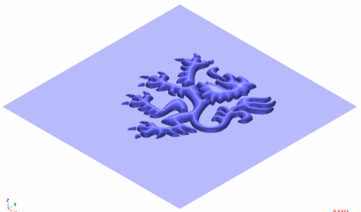


X5 Art New Processes Copy-Paste
Copy Paste Process
Create a surface
Copy to ASL
Paste into Art surface
Notes:
Use Copy and Paste functions to build libraries and motivate students.

Slide 18




X5 Art New Processes Copy-Paste
Create Libraries
  Font Old English
Jewelry
  Bases
  Loops
Notes:
Have students create libraries of fonts, art, jewelry components, sports and school logos to paste into projects

Slide 19




X5 Art New Processes Copy-Paste
Build 3d Surfaces Pick and Place
1 Pick Base
2 Pick Letters
3 Pick Loop
Shade and Crop
Notes:
Here is how the process works

Slide 20
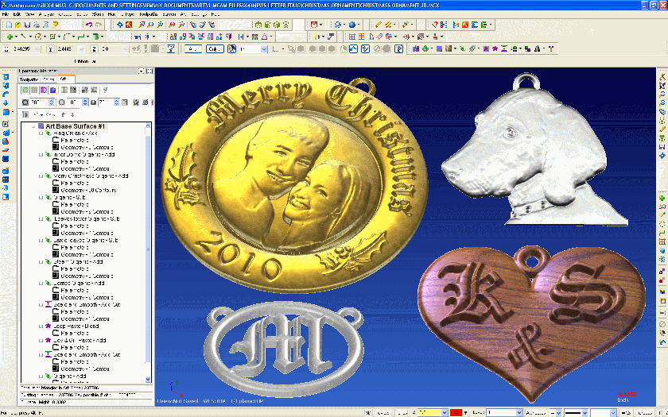

X5 Art New Processes Copy-Paste
Applications
Notes:
Libraries can be applied to different projects, Christmas tree ornaments, pendants, signage, etc.

Slide 21
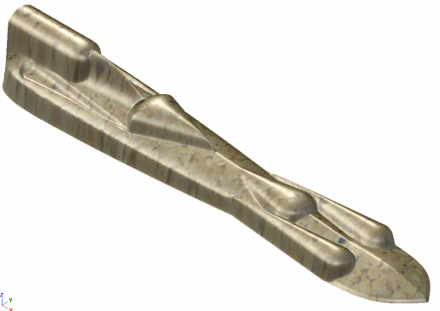
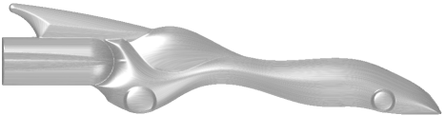
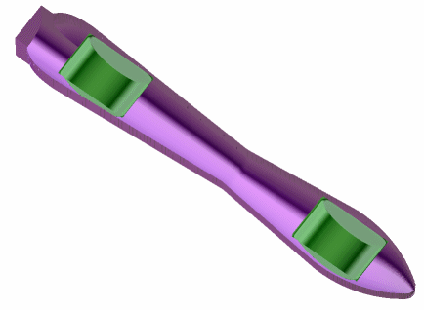
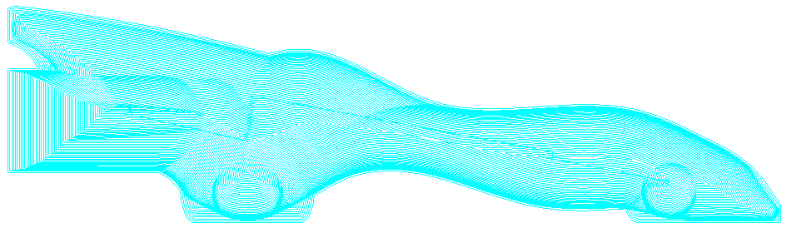
X5 Design C02 cars with Art
Design From Top
Design from Side
Design Shell Cars
Single Toolpath
Custom shading
and textures
Notes:
Here is how the process works

Slide 22
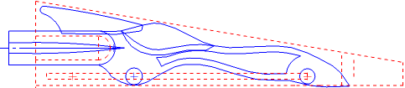
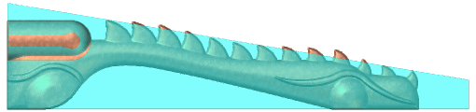
X5 Design C02 cars with Art
Use templates to check design
2D side Template
3D Template catches excesses
Notes:
Here is how the process works

Slide 23

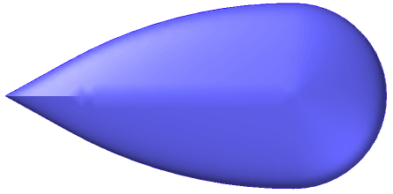
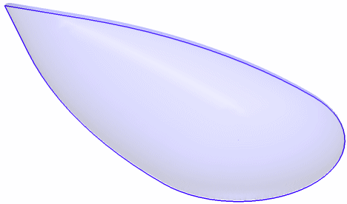
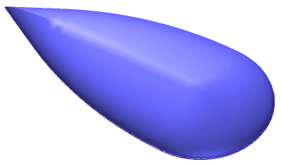
X5 Art C02 Design
Creating Art surfaces
  Select 2D boundary
  Select cross section
  3D surface created
Top view Isometric translucent
Notes:
Here is how the process works

Slide 24




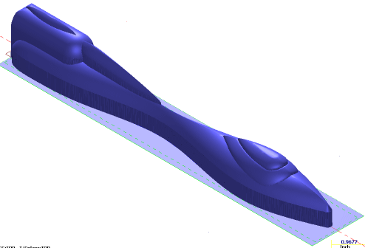
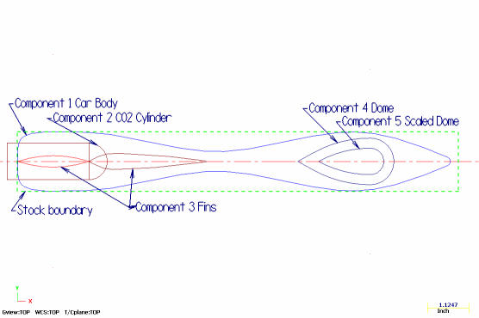
X5 Design C02 cars with Art
Paste from 2D component library
Body Cartridge Canopy Fin
Dynamic Placement
-Rotation
-Scaling
-Mirroring
Notes:
Here is how the process works

Slide 25
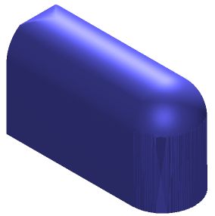
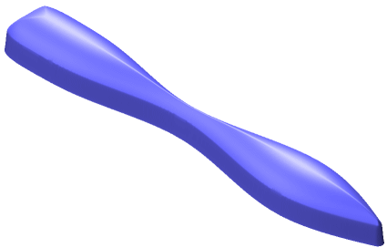
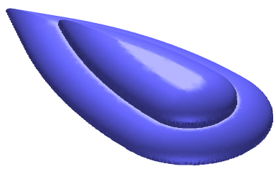
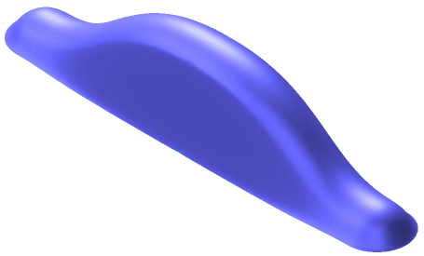
X5 Design C02 cars with Art
Paste surfaces from 3D Library
Body Cartridge Canopy Fender
Dynamic Placement
-Rotation
-Scaling
-Add
-Blend
-Subtract
Notes:
Here is how the process works

Slide 26
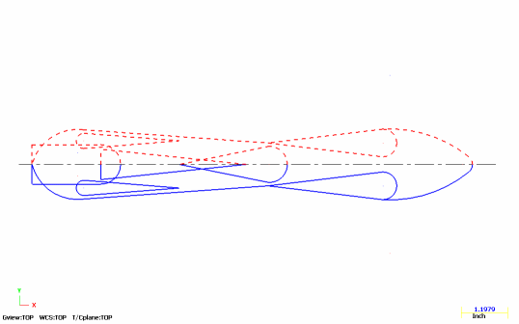
X5 Design C02 cars with Art
Custom Design
Draw 2D design (just half then mirror)
Create Art Surfaces
Notes:
Here is how the process works

Slide 27
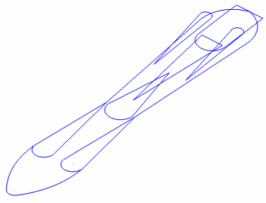
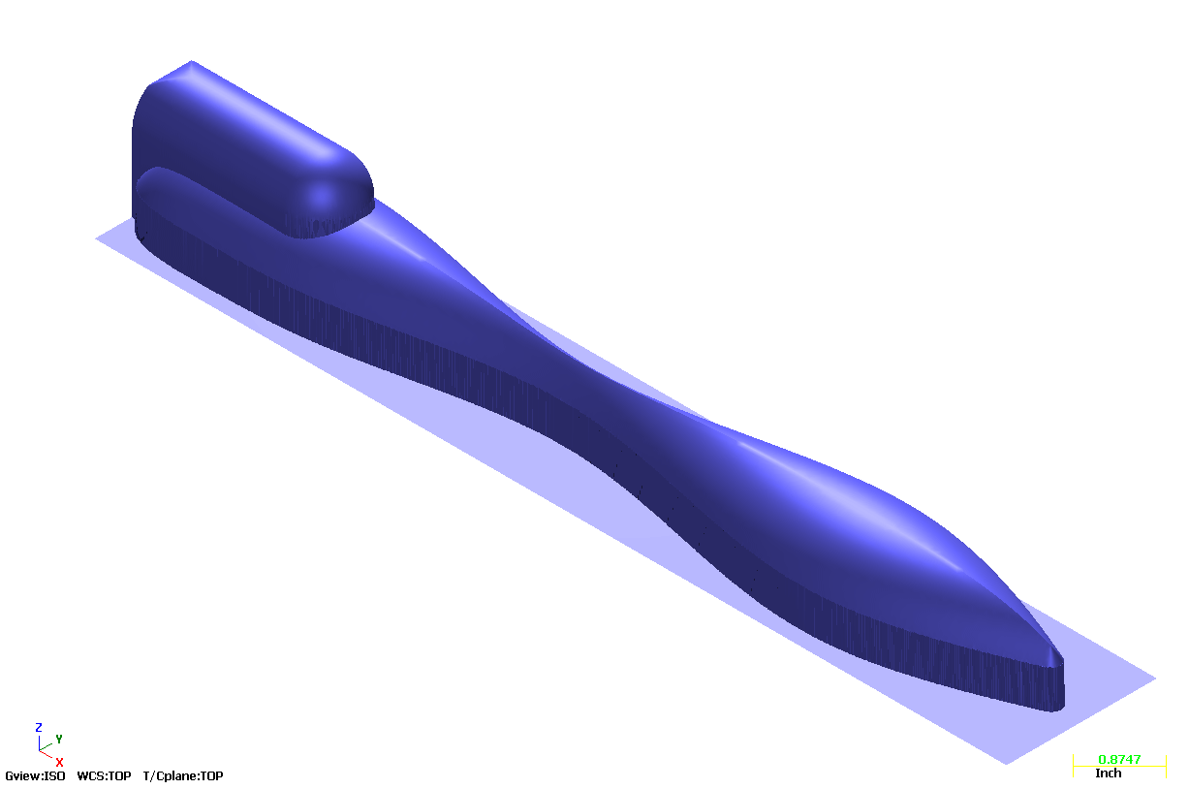
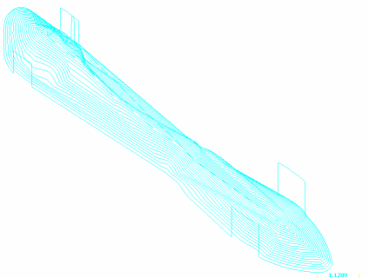
X5 Art C02 Design
Design from the top
Simple 2D layout
Quick Art surfaces
Single toolpath
Notes:
Here is how the process works

Slide 28

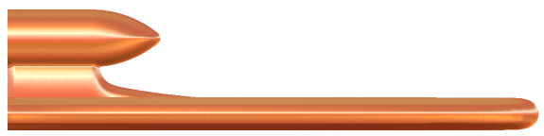
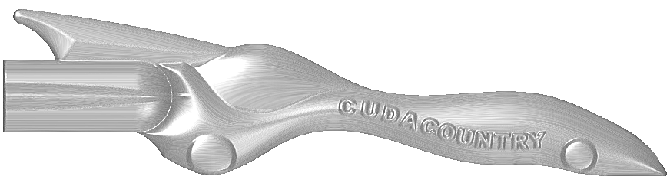
X5 Art C02 Design
Design From Side
Notes:
Here is how the process works

Slide 29
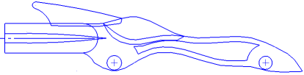
X5 Art C02 Design
Simple 2D design
Quick Art Surfaces
Single toolpath
Notes:
Here is how the process works

Slide 30


X5 Art C02 Design
Simply flip toolpath for left side
Notes:
Here is how the process works

Slide 31


X5 Art C02 Design
High detail design is easy in Art
Notes:
Here is how the process works

Slide 32
X5 Art C02 Design
Even shell cars are easy in Art
Notes:
Here is how the process works

Slide 33
CNC Software, Inc.
Recruiting- Prepared Instructors
X5 Tools Summer Teacher Training
Learn from the experts
Network with other instructors
Take home motivational projects
Meet your support network
Notes:
HLE motivates and excites students, by letting them work at home on their own projects, they can go farther and faster.

Slide 34
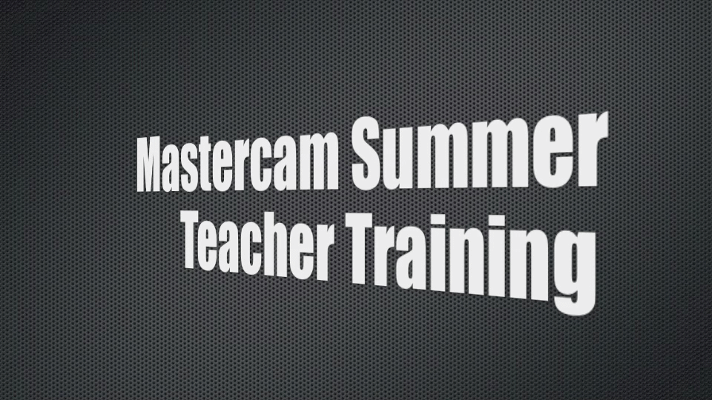
Mastercam Summer Teacher Training
Teacher Training Video
Click Graphic
Notes:
Art introduction video, click on graphic

Slide 35
CNC Software, Inc.
Recruiting- Personal Mastercam
X5 Tools Home Learning Edition
Students want to:
Work at their own speed
On their own time,
Using current technology.
Notes:
HLE motivates and excites students, by letting them work at home on their own projects, they can go farther and faster.

Slide 36
Home Learning Edition HLE
Free to Students
Works for students in school
  Saves .emcx, Reads .mcx
Not for classroom use.
Includes Mastercam:
  Mill and Multi-Axis, Lathe,
  Router, Art, Wire
  Toolpath, Verification, etc.

Slide 37
CNC Software, Inc.
Recruiting – Engaging Students
Online Learning and Certification
X5 Tools MastercamU
Online training, flexible and engaging
the road to certification
Notes:
Mastercam U teaches best practice and procedures using the most current release of Mastercam.

Slide 38


Slide 39

Mastercam University
Learn at your own pace
• Available anywhere over the Web
Affordable
College credit
Learn from the pros
Increase productivity
Baseline training
needs covered

Slide 40

College Credit
Many colleges are adopting the Mastercam U online courses to enhance their training, keeping it up-to-date and more robust.
What’s new in Mastercam X5.PDF
Has 86 pages to explain new functions.
How do instructors keep up?

Slide 41
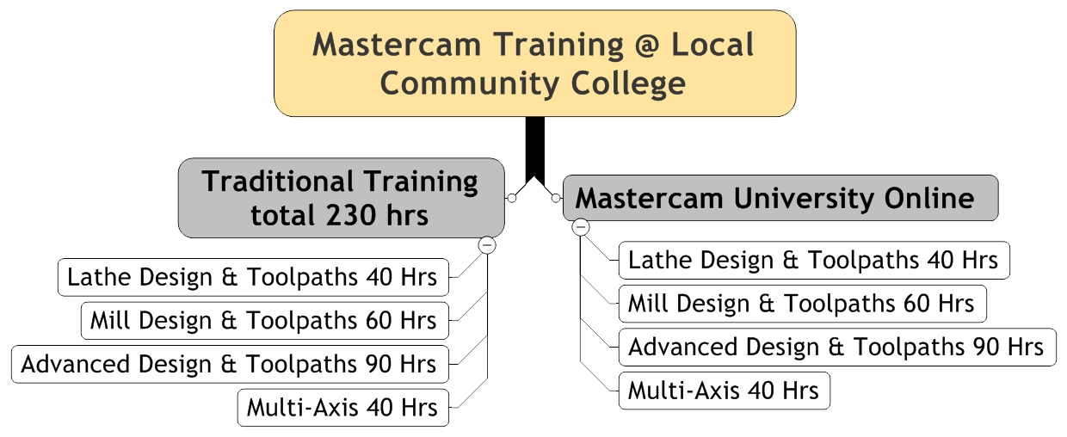
Time to meet industry needs
Q: How is an instructor going to prepare a student for the needs of industry
A: Assign the Mastercam U Base level instruction as
Independent Learning Modules.

Slide 42
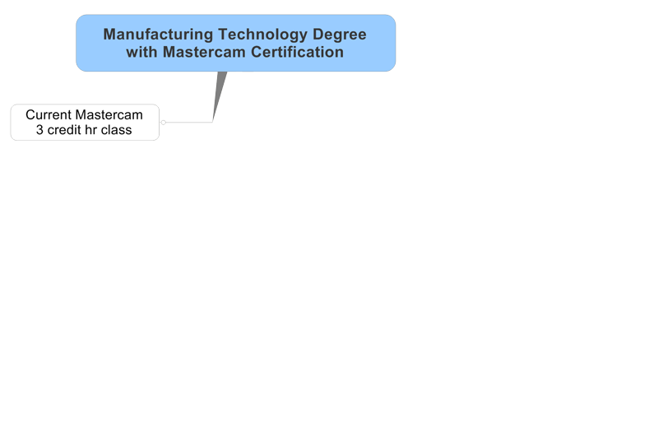
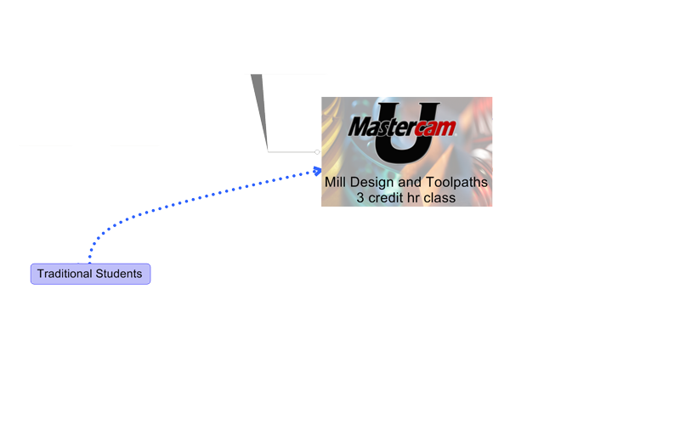
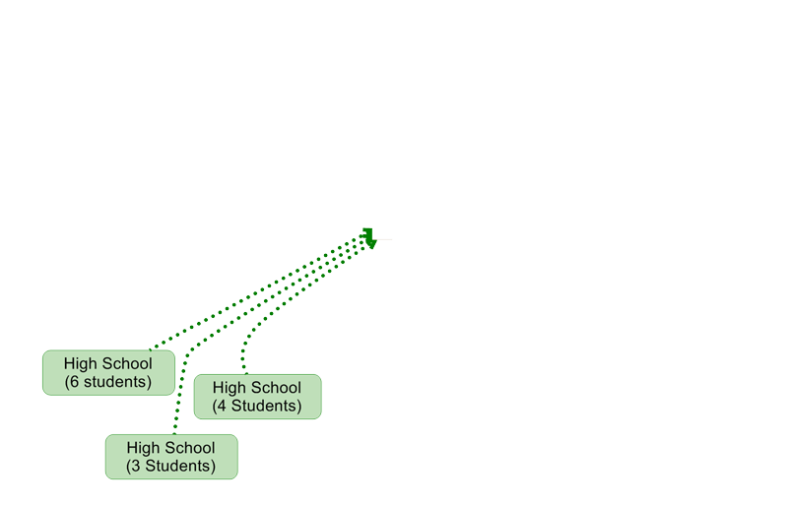
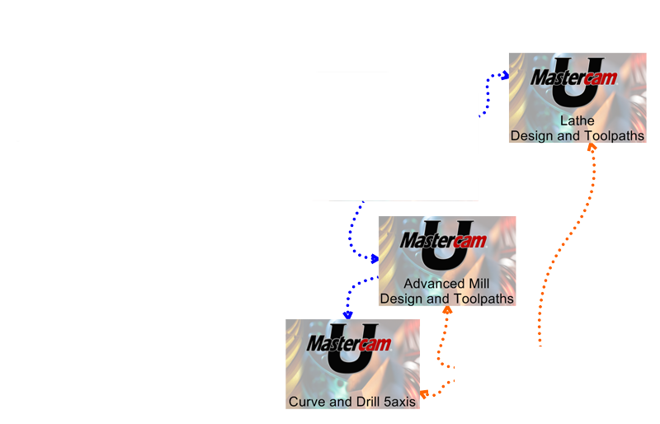

Open Your Program to new Students
This model can open your program to additional students
with little or no additional work.
Notes:
MastercamU also is used for Work Force Development

Slide 43

Online Certificate of Completion
Take away
“Certificate of Completion” with your grade.
  Downloadable PDF.
Notes:
Certificate of completion with score of below 80%
80% and greater, Associate Certification
8% and the application test, Academic Certification

Slide 44
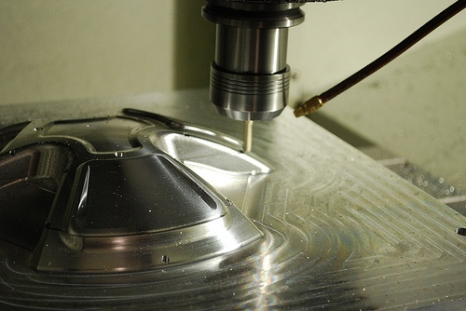
Current Curriculum
Instructor Certification
Principles of Machining
Designed to meet National STEM Standards
Engineering Design for Manufacturing
(High School-New, completion eminent)
Mill Design and Toolpaths
The road to Certification
Advanced Mill (Includes Rotary Axis)
Lathe
Will include C and Y-axis live tooling
Mastercam for SolidWorks
V9-X Transitions
All courses include
Free Home Learning Edition

Slide 45
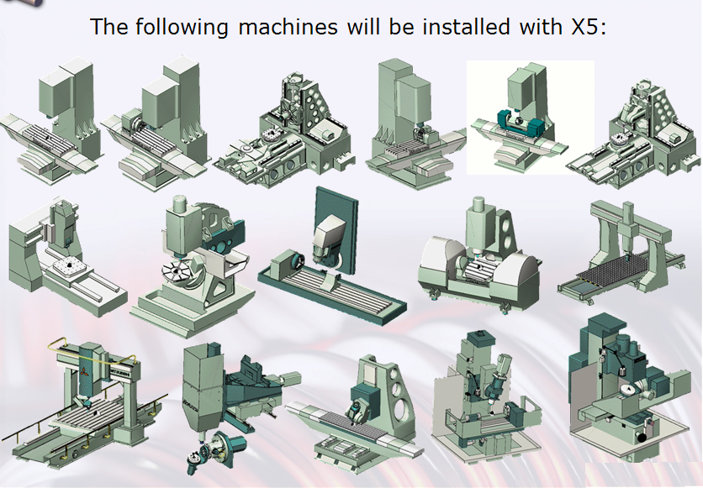
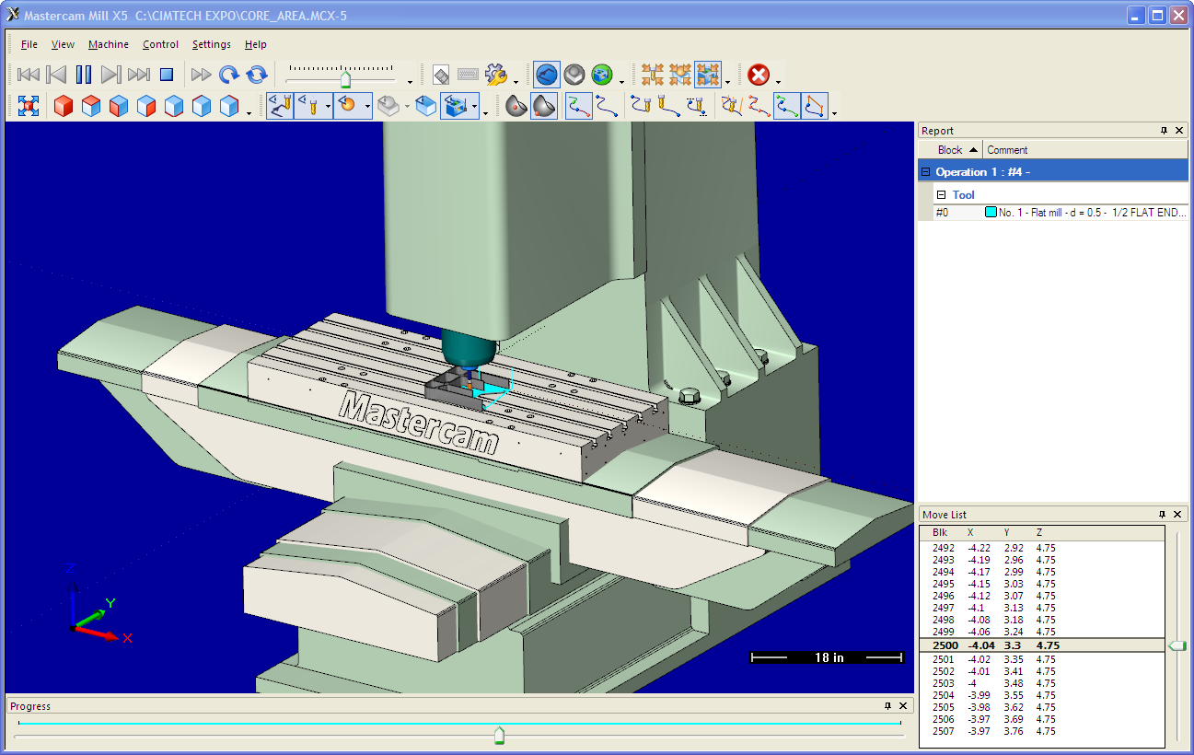
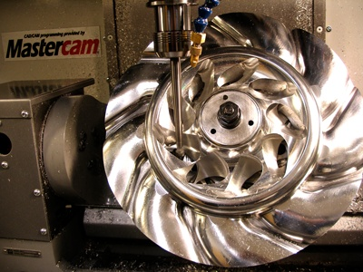
New Courses
Multi Axis-Curve Drill
Machine
Simulation
  Machine
  Library

Slide 46
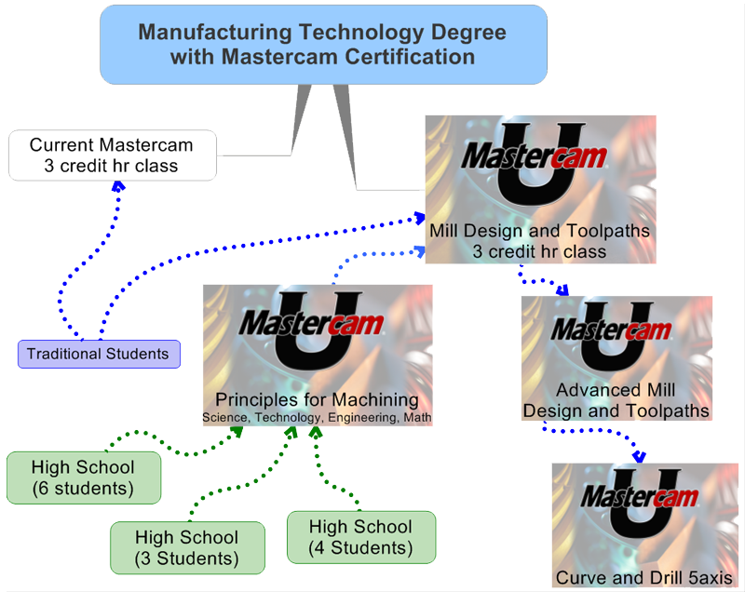
Notes:
Technical Program students, and take Mill Design and Toolpath and Principles for Machining at the same time.
High school students could take Principles for Machining then Mill Design and Toolpaths
Dual Credit, as the high schools are taking the same course, the Technical School could offer dual credit.
If the Tech student wants to go further, and the class is not offered , then they just need to take the next course, as independent study,

Slide 47
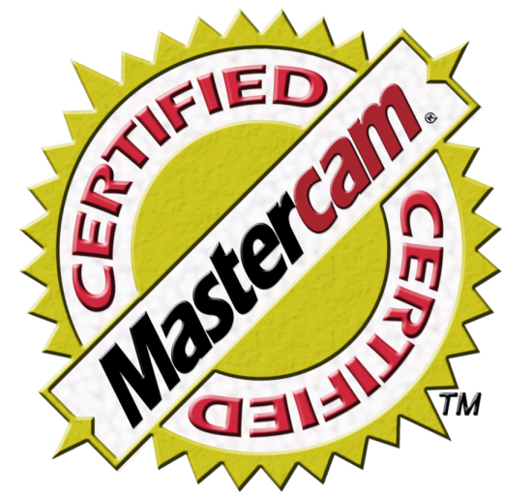
Mastercam Certification
Certification
It is really all
about the test

Slide 48

Mastercam Certification
What is Mastercam Certification?
Setting a measurable standard for Mastercam users
  It is all about the Tests
  You are certified when you
  pass the tests
  Your Mastercam
  competency is validated

Slide 49
Levels of Certification
  Certificate of Completion
  Score less than 80% on tests
  Associate Certification
  80%or greater on the test
  Academic Certification
  80% or better on a
  proctored test

Slide 50
Academic and Professional Level
  The Practical Timed Test
  Doesn’t require machining
  Based on board selected national competencies.
  Covers CAD design and CNC
  toolpath competencies
  Graded by a Mastercam
  Certified instructor

Slide 51
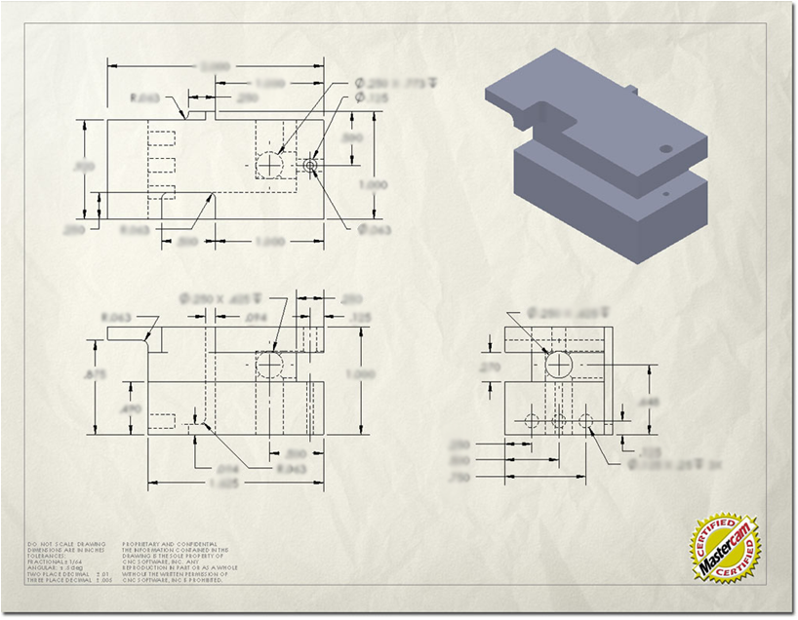

Dimensioned Print
  Start with a print, student then
  designs and toolpaths the part.

Slide 52
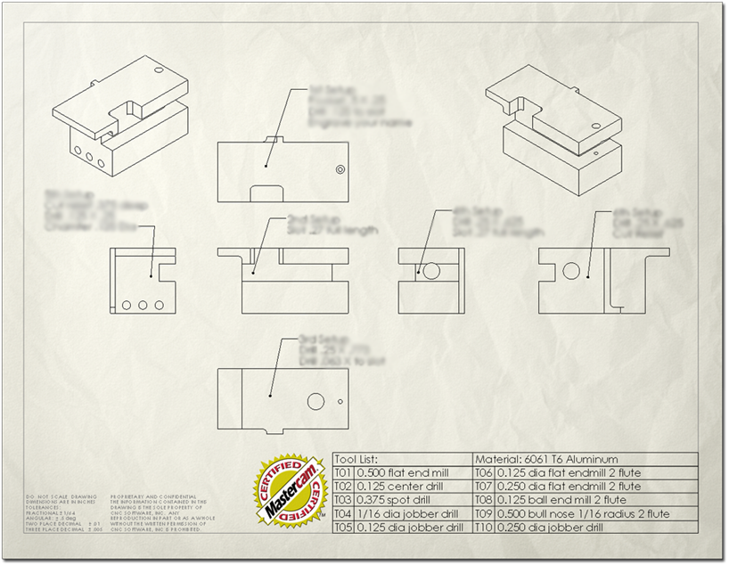
Test includes:
Multiple Setups (WCS), Tools, toolpaths and more.
Dimensioned Print

Slide 53
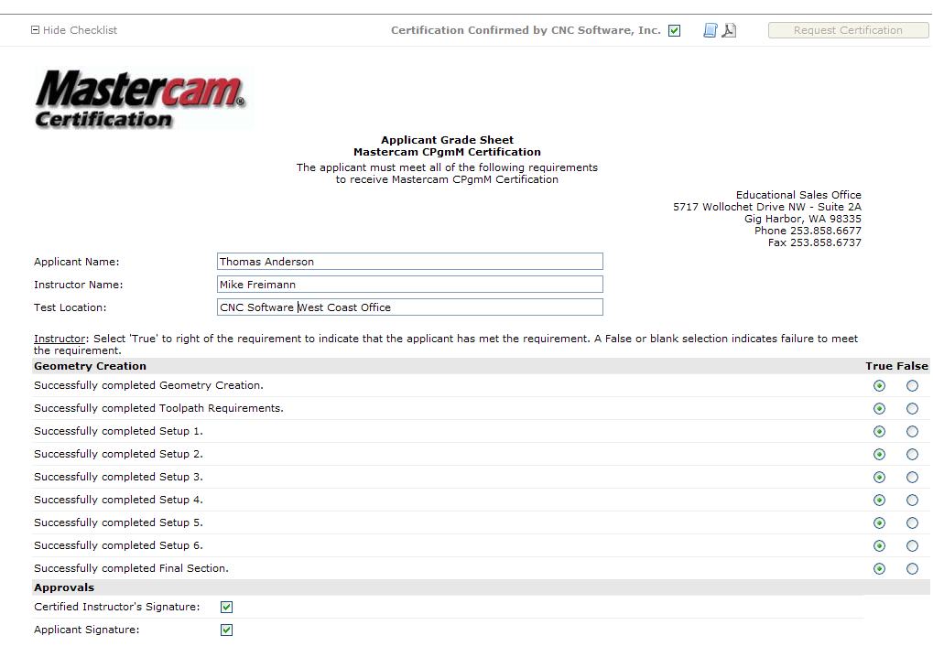
Instructor Responsibility
  Instructor and school certify the
  students abilities.

Slide 54

Student Certification Certificate

Slide 55
Instructor Certification
Instructor Certification Course $375
Basic Design/Toolpath Course
How to grade the test
Certify by:
Designing and Toolpathing the final part, (no time limit for instructors).
Contact: Iven.May@Mastercam.com

Slide 56
Questions?
Thank you!

